Slide 1
Corporate
Social Responsibility
Akshay Jagadeesh
Jee Su Byun
Zepeng Huo
Dior Xiong

Slide 2
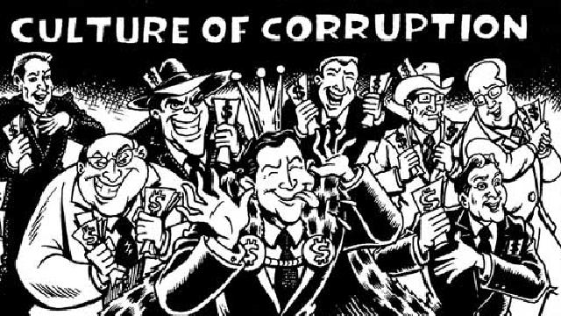
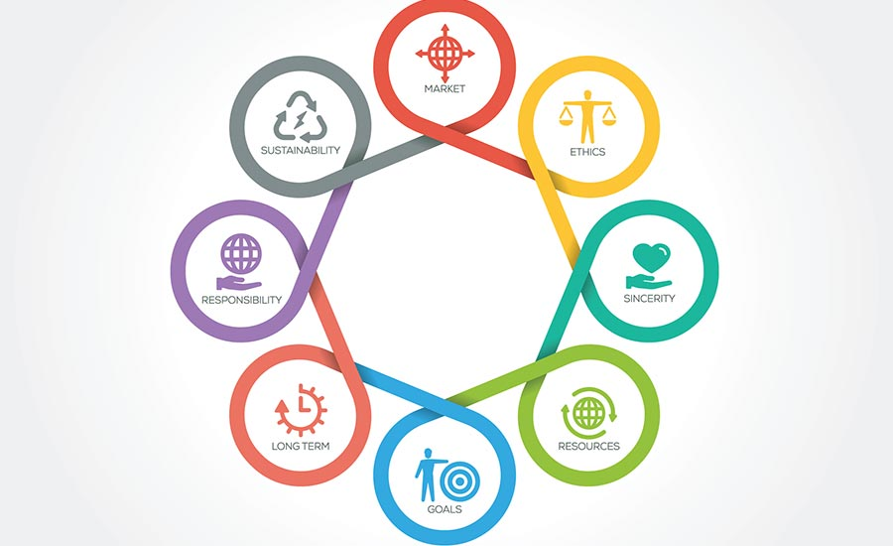
Motivation
Constant controversial news from corporations (i.e Facebook, Uber, Blizzard, NBA)
Corporate Social Responsibility Reports released per year
Talks about ethics and what the company hopes to achieve (i.e HPE wishes to put more women in higher positions)
First Motivation: Modeling company values
Second Motivation: Finding out how the public views these companies to assess if they are truly ethical

Slide 3

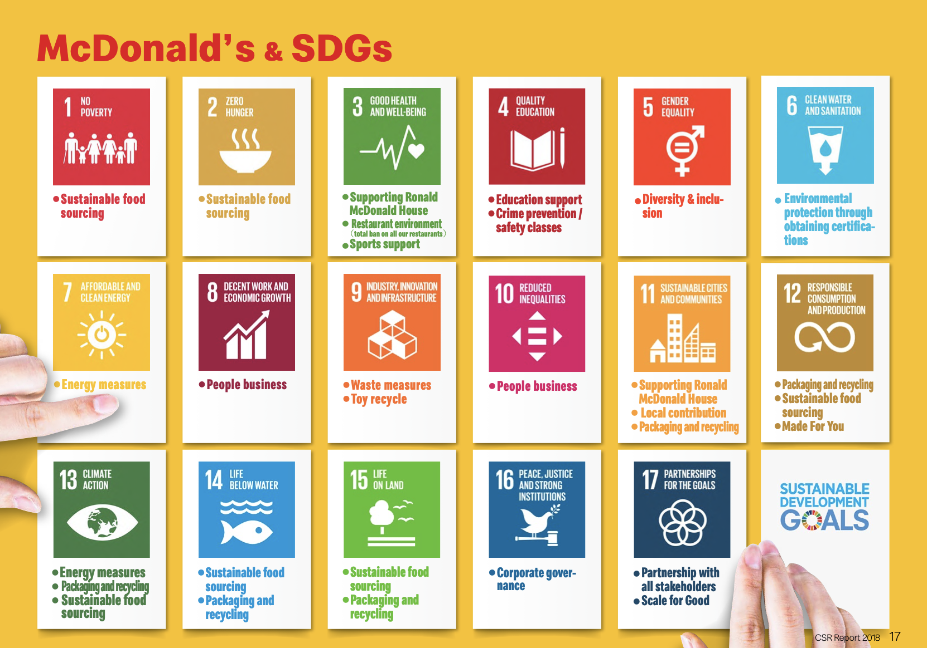
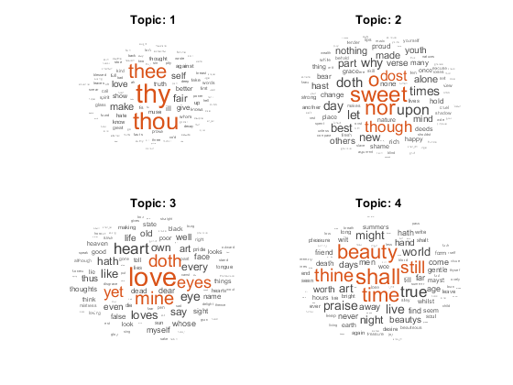
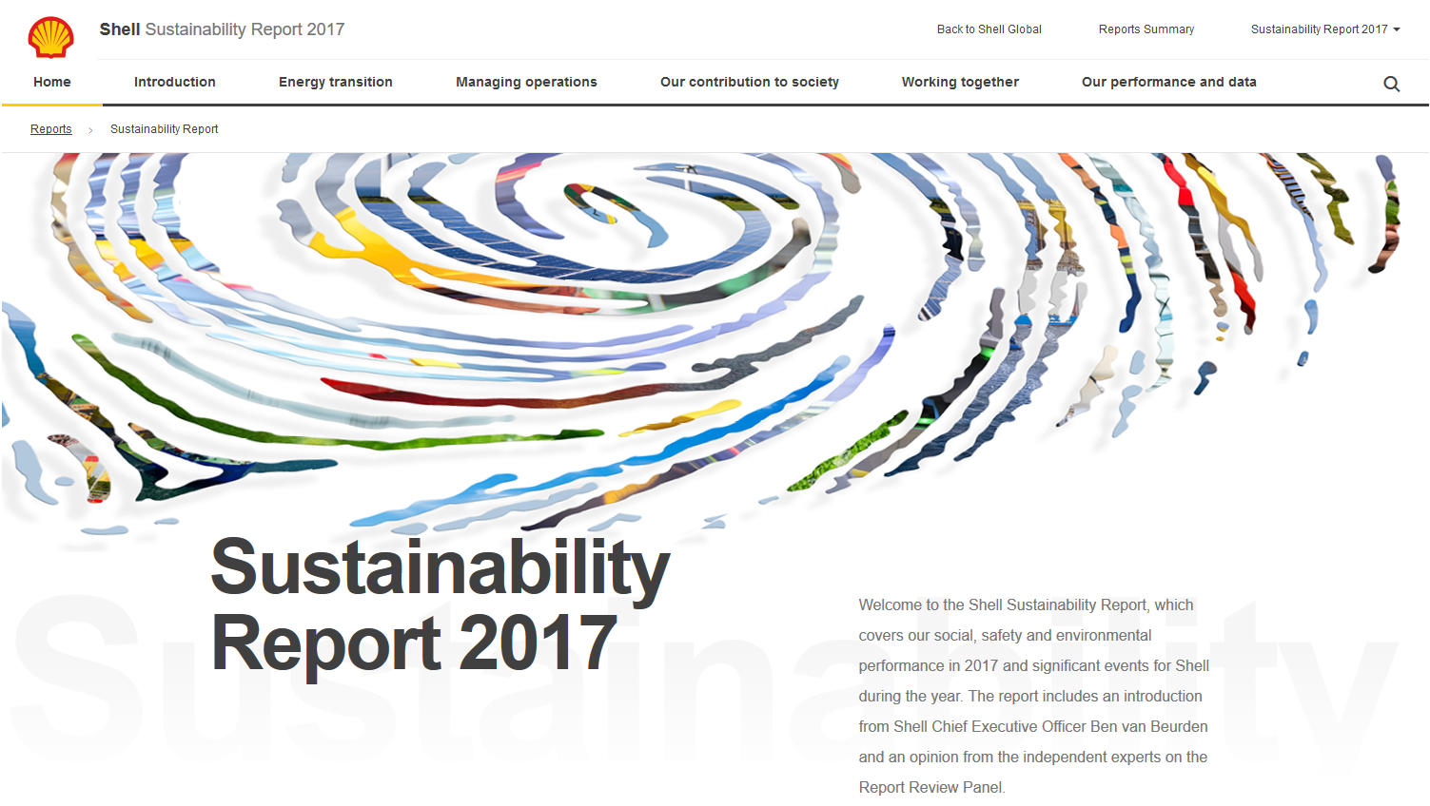
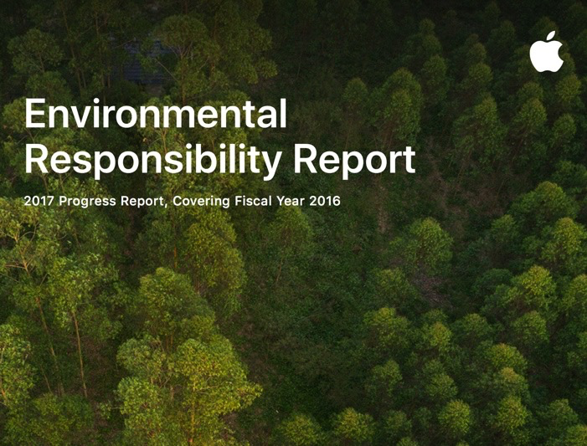
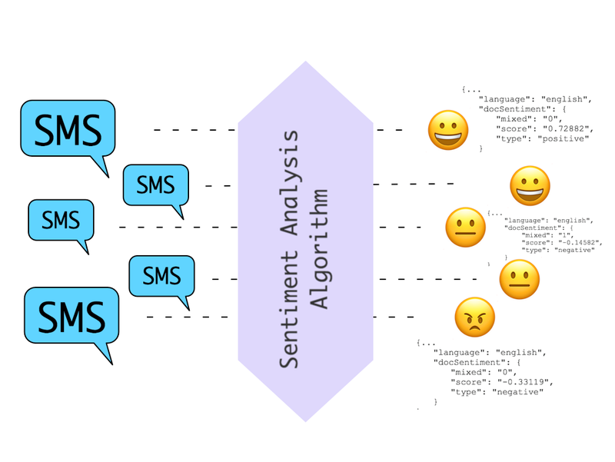
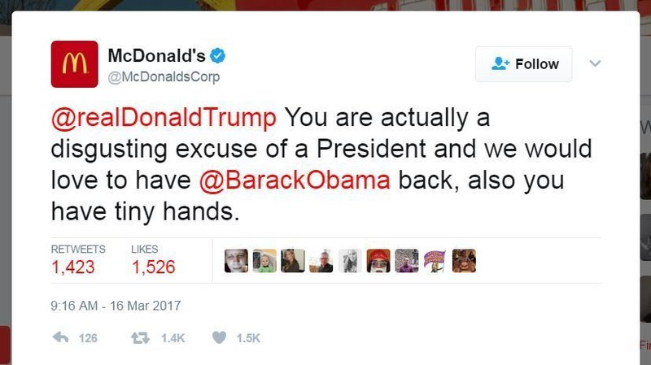
Proposed Method
Data
CSR reports
Twitter tweets
Methodologies
LDA
Sentiment Analysis
Notes:
CSR(Corporate Social Responsibility) reports
We examine the extent to which environmental sustainability has become embedded in corporate policy and core business discourse by analyzing CSR Reports of a sample of Fortune 500 companies. We will first attempt to find preprocessed dataset of CSR reports online and then either crawl or download complete CSR reports for the remaining companies in PDF format from the corresponding official corporate websites. We will also attempt to create a good balance of different types of industries so that the algorithm can have a more balanced approach.
Twitter
On the basis of a large corpus of public Twitter posts we also look specifically at the interplay between corporate social activities and the public’s attitude toward the companies.
What is your "data mining" toolkit? You should list specific methods you will implement.
We will use latent Dirichlet allocation (LDA), a generative statistical model to find the topics in the corpus we gather, and will categorize them into sub-groups. Each group will represent a broadly-defined topic, so that we can make semantically meaningful topic labels to each sub-group and see how each company’s CSR report match the topics.
We then extract the social media’s public reactions towards those company’s reports from Twitter. We perform a sentiment analysis of tweets filtered by the keywords ‘#company_name’
and ‘#social_keyword’ in the same time period as the years CSR reports (explained below) are published. We then extract 6 emotional mood states (tension, depression, anger, vigor, fatigue, confusion) [2] to compute a 6-dimensional mood vector representing each company.

Slide 4

Expected Results
We have a number of categories of companies, such as Retail, Chain Restaurant, Energy, Technology, Automobiles, etc.
External Comparison
We compare the public reaction towards those companies by using sentiment analysis and see which one has the most positive reaction in their domain
Internal Comparison
We study one company and compare how the sentiment towards this company shift over the years and see if they are improving
Notes:
Finally, what do we hope to learn from this project? What metrics or viz or outcomes will there be? For my project, I aim to achieve an accuracy of 80%. I will uncover important features of the images that are insightful for deforestation.
In proposal (below)
We hope to see if these companies are actually doing what they say are doing. A good way to measure this would be to look at the perceptions of the general public, which will be represented by Twitter. We will look at the overall Twitter sentiment value toward a company and see if it is positive or negative. If it is positive, we will say that a company is upholding its ethical image. However, if it is negative, we would assume the opposite.
Another thing we hope to find is how these CSR reports change over time. There is generally, one CSR report released a year, so we want to look at how a company’s CSR report is different from the previous years. For example, we would look at McDonald’s CSR report from 2008 to 2018 and see how their values have changed over time.

Slide 5
Expected Results
External and internal comparison
We have a number of categories of companies, such as Retail, Chain Restaurant, Energy, Technology, Automobiles, etc.
First, We compare the public reaction towards those companies by using sentiment analysis and see which one has the most positive reaction in their domain (external)
Second, we study one company and compare how the sentiment towards this company shift over the years and see if they are improving (internal)
Notes:
Finally, what do we hope to learn from this project? What metrics or viz or outcomes will there be? For my project, I aim to achieve an accuracy of 80%. I will uncover important features of the images that are insightful for deforestation.
In proposal (below)
We hope to see if these companies are actually doing what they say are doing. A good way to measure this would be to look at the perceptions of the general public, which will be represented by Twitter. We will look at the overall Twitter sentiment value toward a company and see if it is positive or negative. If it is positive, we will say that a company is upholding its ethical image. However, if it is negative, we would assume the opposite.
Another thing we hope to find is how these CSR reports change over time. There is generally, one CSR report released a year, so we want to look at how a company’s CSR report is different from the previous years. For example, we would look at McDonald’s CSR report from 2008 to 2018 and see how their values have changed over time.

